Slide 1
OpenCV-Python Tutorial
Jinyuan Zhao
11/6/2017

Slide 2
OpenCV-Python
Easy to install and use
Install OpenCV-Python on Windows (works for Python 2.7, 3.4, 3.5 and 3.6):
https://www.scivision.co/install-opencv-python-windows/
Print the version of OpenCV in Python:
If the results are printed out without any errors, then OpenCV-Python is installed successfully.
>>> import cv2
>>> print(cv2.__version__)

Slide 3
OpenCV-Python Basic Operations
Import the libraries
Read an image
First argument: image file name (use single quote)
Second argument: the way to read images
1: read image in RGB (no alpha channel)
0: read image in grayscale
-1: read image in RGB, including alpha channel
>>> import numpy as np
>>> import cv2
>>> img = cv2.imread(‘image.jpg', 1)

Slide 4
OpenCV-Python Basic Operations
Save an image
Create a window and display an image in the window
cv2.namedWindow flag options:
cv2.WINDOW_NORMAL or cv2.WINDOW_AUTOSIZE – The latter will fit the window size to the image
cv2.WINDOW_FREERATIO or cv2.WINDOW_KEEPRATIO – Determines whether to keep the aspect ratio of the displayed image when adjusting window
>>> cv2.imwrite(‘save_image.png', img)
>>> cv2.namedWindow(‘WindowName', cv2.WINDOW_NORMAL | cv2.WINDOW_FREERATIO)
>>> cv2.imshow('WindowName', img)
>>> cv2.waitKey(0)
>>> cv2.destroyAllWindows()

Slide 5
OpenCV-Python Basic Operations
Access pixel values
Grayscale images: 2-dimensional array (W×H)
Color images: 3-dimensional array (W×H×3)
- if img is a grayscale image - if img is a color image
>>> px = img[100, 100]
>>> print(px)
29
>>> px = img[100, 100]
>>> print(px)
[255 0 0]
>>> blue = img[100, 100, 0]
>>> print(blue)
255

Slide 6
OpenCV-Python Basic Operations
Change pixel values
Grayscale images: 2-dimensional array (W×H)
Color images: 3-dimensional array (W×H×3)
- if img is a grayscale image - if img is a color image
or
>>> img[100, 100] = 255
>>> img[100, 100] = [255, 255, 255]
>>> img[100, 100, 0] = 255
>>> img[100, 100, 1] = 255
>>> img[100, 100, 2] = 255

Slide 7
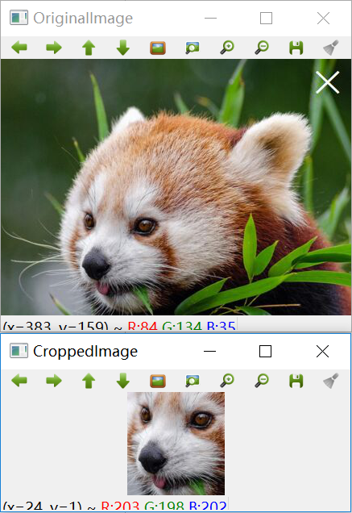
OpenCV-Python Basic Operations
Crop an image
>>> img = cv2.imread('image.jpg',1)
>>> cropped_img = img[173:301, 87:208]
>>> cv2.namedWindow('OriginalImage', cv2.WINDOW_AUTOSIZE)
>>> cv2.namedWindow('CroppedImage', cv2.WINDOW_AUTOSIZE)
>>> cv2.imshow('OriginalImage', img)
>>> cv2.imshow('CroppedImage', cropped_img)
>>> cv2.waitKey(0)
>>> cv2.destroyAllWindows()

Slide 8
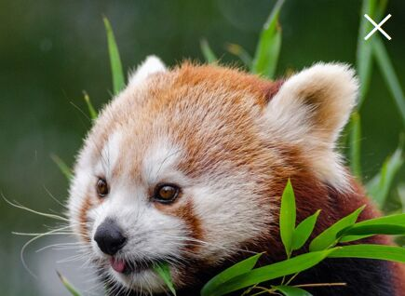
OpenCV-Python Basic Operations
Image properties
>>> print(img.shape)
(318, 435, 3)
>>> print(img.size)
414990
>>> print(img.dtype)
uint8

Slide 9
OpenCV-Python Basic Operations
Drawing functions
cv2.line
cv2.rectangle
cv2.circle
cv2.ellipse
cv2.polylines (Drawing a polygon)
cv2.putText (Adding text on an image)

Slide 10
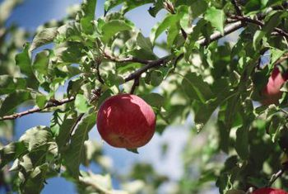

Object Detection using Template Matching
Goal: Detect and locate an object in an image
Source Image
Template Image

Slide 11
Object Detection using Template Matching
Goal: Detect and locate an object in an image
Source Image
Template Image

Slide 12


Object Detection using Template Matching
Correlation (similarity) between images
More correlated
Template Image
Less correlated

Slide 13
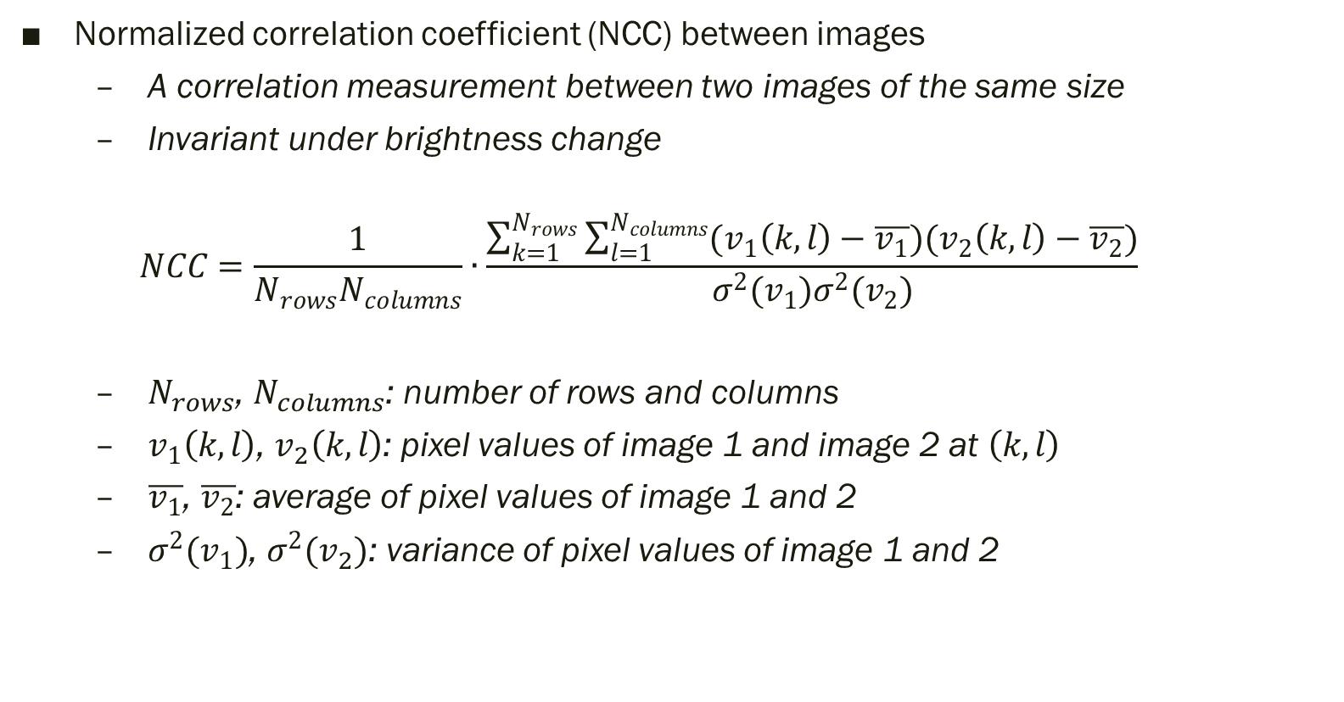
Object Detection using Template Matching
Normalized correlation coefficient (NCC) between images
A correlation measurement between two images of the same size
Invariant under brightness change
$$NCC=\frac{1}{N_{rows}N_{columns}}∙\frac{\sum_{k=1}^{N_{rows}}{\sum_{l=1}^{N_{columns}}{(v_{1}\left(k, l\right)−\overline{v_{1}})(v_{2}\left(k, l\right)−\overline{v_{2}})}}}{σ^{2}(v_{1})σ^{2}(v_{2})}$$
$N_{rows}$, $N_{columns}$: number of rows and columns
$v_{1}\left(k, l\right)$, $v_{2}\left(k, l\right)$: pixel values of image 1 and image 2 at $\left(k, l\right)$
$\overline{v_{1}}$, $\overline{v_{2}}$: average of pixel values of image 1 and 2
$σ^{2}(v_{1})$, $σ^{2}(v_{2})$: variance of pixel values of image 1 and 2

Slide 14
Object Detection using Template Matching
Template matching algorithm
Slide the template image on the source image
Calculate NCC at each sliding position
Best match: where NCC is maximum

Slide 15
Object Detection using Template Matching
Template matching algorithm
Slide the template image on the source image
Calculate NCC at each sliding position
Best match: where NCC is maximum

Slide 16
Object Detection using Template Matching
Template matching algorithm
Slide the template image on the source image
Calculate NCC at each sliding position
Best match: where NCC is maximum

Slide 17
Object Detection using Template Matching
Template matching algorithm
Slide the template image on the source image
Calculate NCC at each sliding position
Best match: where NCC is maximum

Slide 18
Object Detection using Template Matching
Template matching algorithm
Slide the template image on the source image
Calculate NCC at each sliding position
Best match: where NCC is maximum
Best match!

Slide 19
Object Detection using Template Matching
Exercise
Take a photo of an object (template image)
Take a photo yourself holding the same object (source image)
Resize the template image to roughly the same size as the object in the source image
Download TemplateMatching.py from the class Drive folder
Use OpenCV-Python to Complete template matching algorithm and draw a red rectangle at the best match position
Tips:
Downsize the source image for shorter running time (Recommended size: 640×480)
Load both images in grayscale
Set an appropriate step size for sliding (Recommended: 15~20)
Be patient. It takes some time to run the algorithm

Slide 20
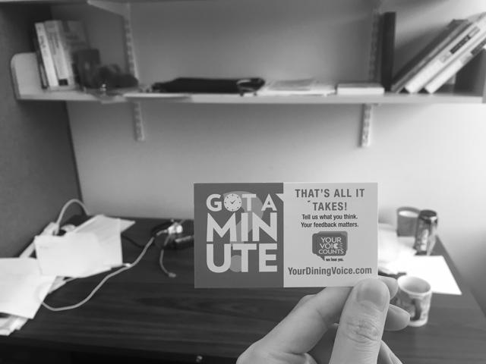

Object Detection using Template Matching
Example
Template Image
Source Image

Slide 21
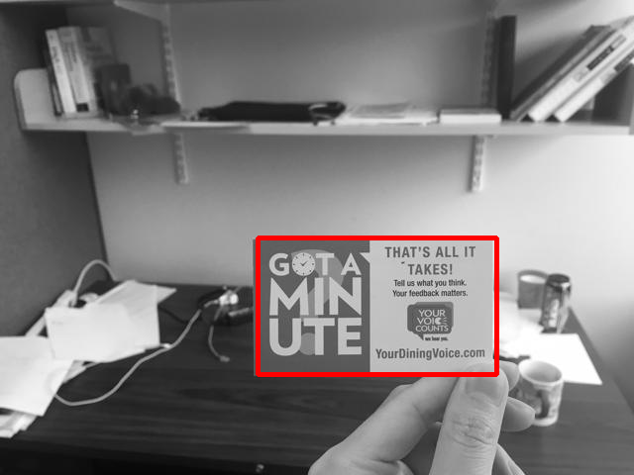
Object Detection using Template Matching
Example
Template Matching Result

